Slide 1
Secure Data Hiding in Image Using Steganography
CYBERSECURITY PROJECT
Presented By: SOURODIP KAR
Student Name : SOURODIP KAR
College Name & Department : Narula Institute Of Technology

Slide 2
OUTLINE
Problem Statement
Technology used
Wow factor
End users
Result
Conclusion
Git-hub Link

Slide 3
Problem Statement
With rising cybersecurity threats, securing sensitive data is crucial. Traditional encryption makes data noticeable, whereas steganography hides it within images, making detection nearly impossible. This project enhances security by combining AES encryption, adaptive LSB encoding, and passcode hashing to create a highly secure, steganalysis-resistant data-hiding technique.
Key Points:
Data Concealment – Hides encrypted messages inside images. Advanced Security – Uses AES encryption & passcode hashing. Adaptive Encoding – Randomized pixel selection for better protection. Steganalysis Resistance – Harder to detect hidden messages.

Slide 4
Technology used
Python – Core programming language for implementation. Google Colab – Execution and testing. OpenCV – Image processing and manipulation. AES Encryption (PyCryptodome) – Secure message encryption. SHA-256 Hashing – Secure passcode protection.
Least Significant Bit (LSB) Encoding – Data hiding technique.
Adaptive Encoding – Randomized embedding for security. NumPy – Efficient array and pixel operations.

Slide 5
Wow factors
AES-Encrypted Steganography – Unlike LSB methods, this approach encrypts messages using AES-256, ensuring that even if extracted, the data remains unreadable.
Adaptive LSB Encoding – Embeds data in a pseudo-randomized pixel sequence (generated via SHA-256 hash of the passcode), making detection through steganalysis highly difficult.
Passcode Hashing (SHA-256) – Instead of storing raw passwords, hashing them using SHA-256, prevents brute-force attacks and unauthorized decryption.
Steganalysis Resistance – LSB methods modify sequential pixels, making detection easier. Steganalysis approach randomizes embedding locations, reducing statistical anomalies.
Lossless Image Format (PNG) – Uses PNG instead of JPEG to avoid lossy compression, ensuring that hidden data remains intact without degradation.

Slide 6
End users
Cybersecurity Professionals – For secure data transmission without raising suspicion.
Government & Defense Agencies – To exchange confidential information covertly.
Journalists & Whistleblowers – For secure communication in sensitive environments.
Corporate Sector – Protects trade secrets and confidential business data.
Forensic Experts – Helps in secure evidence storage and retrieval.
General Users – Anyone needing a secure and hidden way to store or share sensitive data.

Slide 7
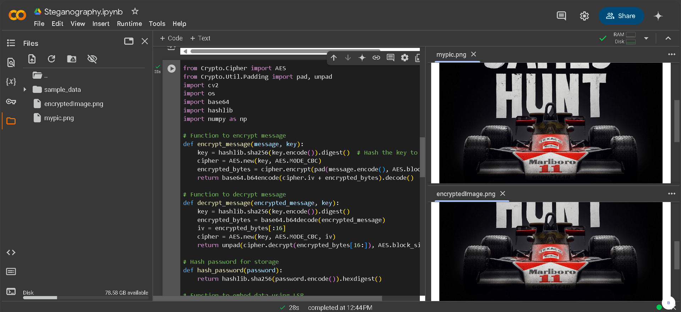
Results

Slide 8
Conclusion
This project effectively integrates cryptography and steganography to provide a highly secure method for data hiding. By using AES encryption, the hidden message remains protected even if extracted. Adaptive LSB encoding with pseudo-randomized pixel selection enhances security by making detection through steganalysis extremely difficult. Additionally, passcode hashing (SHA-256) prevents unauthorized access, ensuring only the rightful user can decrypt the message.
The use of lossless PNG format preserves hidden data without quality loss, making it a reliable solution for secure and covert communication. This approach can be beneficial for various fields, including cybersecurity, defense, journalism, and corporate data protection.

Slide 9
GitHub Link
Github Link - Sourodip20kar/Steganography-Data-Hiding-in-Image
Google Colab Link- Steganography.ipynb

Slide 10
THANK YOU

